Slide 1
MANUAL TESTING
Manual Testing
Manual testing is a software-testing process in which a person executes test cases without using an automated tool.
The tester follows a user scenario, provides inputs, observes the actual result, and compares it with the expected result.
Example: searching for a Netflix science-fiction movie checks usability and user acceptance from a real user’s point of view.
Notes:
Introduce manual testing as a person-led process. Emphasize the sequence: follow a user scenario, provide inputs, observe the actual result, and compare it with the expected result.

Slide 2
SOFTWARE DEVELOPMENT ROADMAP
SDLC: the complete software development roadmap
A structured process used to plan, design, develop, test, deploy, and maintain software.
Planning & Feasibility Analysis
System Design
Testing
Maintenance
Plan the architecture, modules, and data structures for the solution.
Find and fix defects to confirm the software meets its requirements.
Update, fix, and improve the software after it goes live.
Define the project goals and check whether the product is practical and worthwhile.
1
2
3
4
5
6
7
Requirement Specification (SRS)
Development (Coding)
Deployment
Developers write the code and build the working software.
Release the tested software to users in the production environment.
Document what users need in a clear Software Requirement Specification.
SDLC connects user needs and business goals to a product that can be released and supported.
Notes:
Read the roadmap from left to right. Testing is one phase in a larger product journey, connected to both the initial needs and the later release and support work.

Slide 3
TESTING PROCESS INSIDE SDLC
STLC: the testing process inside SDLC
A structured set of testing activities used to check whether a software product meets quality expectations.
STLC · TESTING PHASES
1. Requirement Analysis
2. Test Planning
3. Test Case Development
Testers study the requirements to find what must be tested and whether each one can be tested.
The team sets the scope, goals, effort, resources, schedule, and risks for testing.
Testers write and review test cases and test data based on the requirements.
4. Test Environment Setup
5. Test Execution
6. Test Closure
The hardware, software, and data needed to run the tests are prepared and checked.
Testers run the test cases, record the results, and log any defects found.
The team reviews results against exit criteria and archives the testing evidence.
STLC gives testing its own scope, responsibilities, evidence, defect tracking, and release-readiness decision.
Notes:
Show that STLC is not separate from product development. It is the testing process that runs inside the wider SDLC, with its own activities and evidence.

Slide 4



THREE LEVELS OF SYSTEM KNOWLEDGE
Core Manual Testing Techniques
The difference is how much the tester knows about the internal code and architecture.
White box
Black box
Gray box
Internal code and architecture are visible to the tester.
Testing focuses on inputs, outputs, requirements, and user-visible behavior.
Testing combines external behavior with partial internal knowledge.
Inspect the inside.
Check the outside.
Use both views.
All three approaches can support functional checks, defect discovery, and better release confidence.
Notes:
Use the three boxes as a visual vocabulary for the next three cards. The tester is always working manually; what changes is the level of system knowledge.

Slide 5
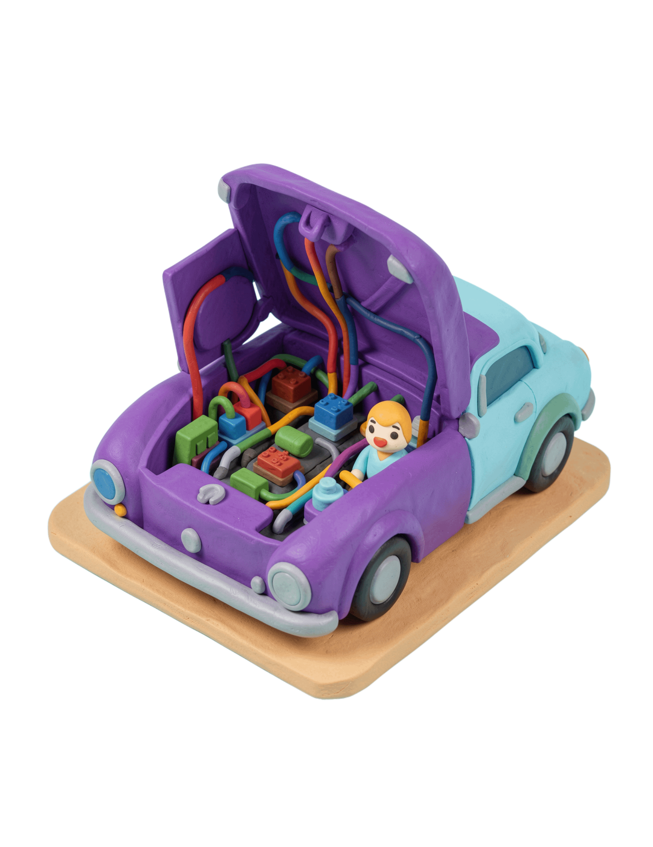
INSIDE THE IMPLEMENTATION
White-box testing
White-box testing examines the internal structure, code logic, branches, data flow, and implementation of an application.
The tester uses programming or design knowledge to verify that the code behaves correctly along important paths.
Opening a car hood to inspect wiring and relays instead of only checking whether the car starts.
Notes:
Use the car analogy to make the inside-versus-outside distinction concrete. White-box testing follows implementation paths, not only the behavior visible to a user.

Slide 6
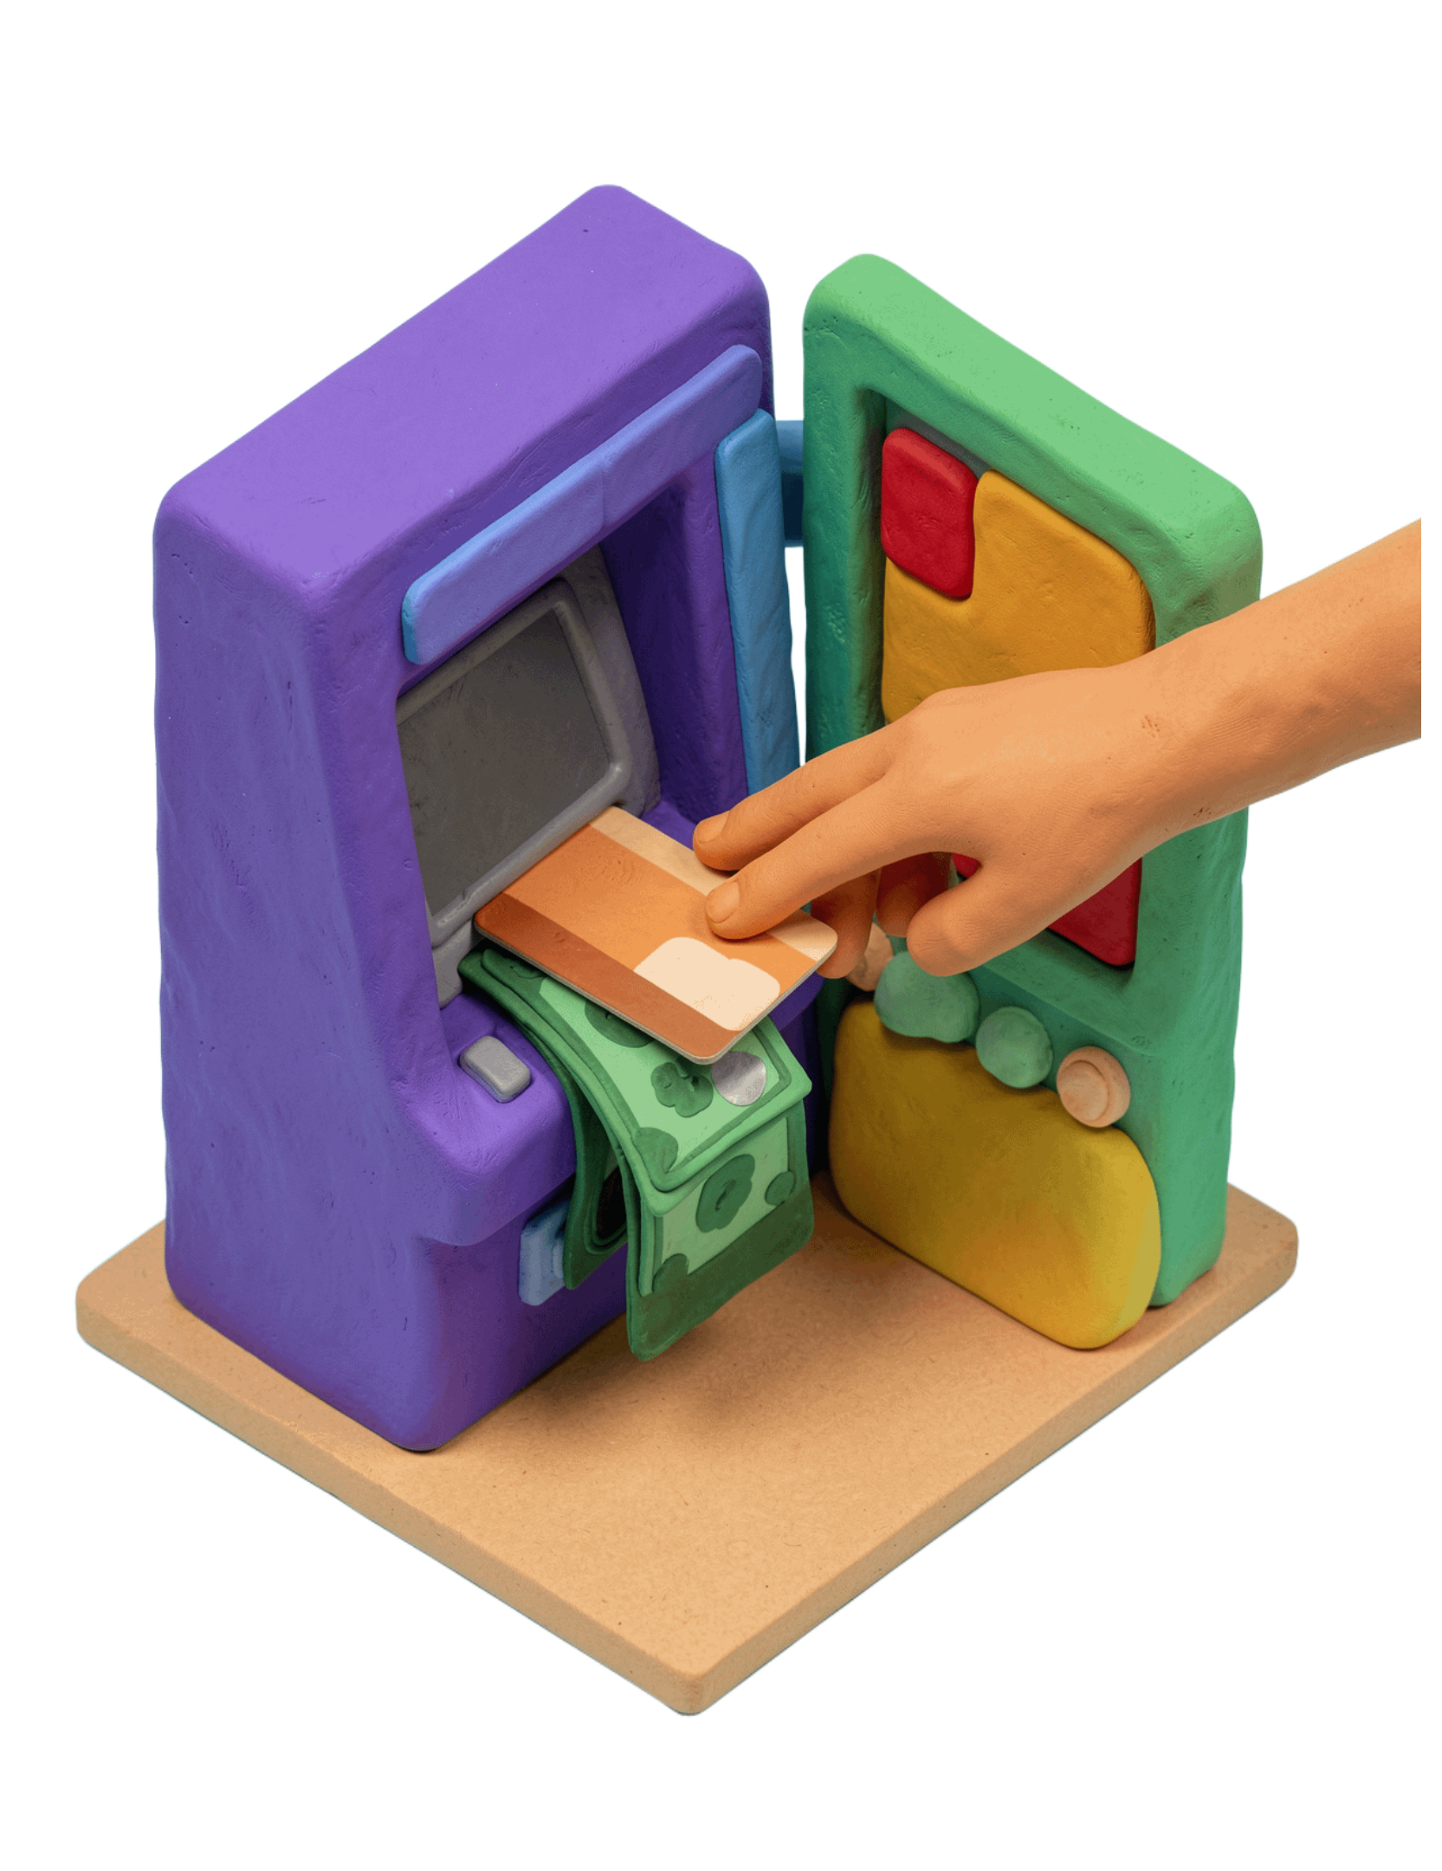
OUTSIDE-IN BEHAVIOR
Black-box testing
Black-box testing validates software behavior without requiring knowledge of the internal code or structure.
The tester concentrates on inputs, outputs, requirements, and user-visible behavior.
ATM withdrawal
Insert a card, request a withdrawal, and verify the cash and balance update without knowing the internal banking flow.
Notes:
Stress that black-box testing does not require the tester to know how the system works internally. The expected behavior is judged from the user-facing inputs and outputs.

Slide 7
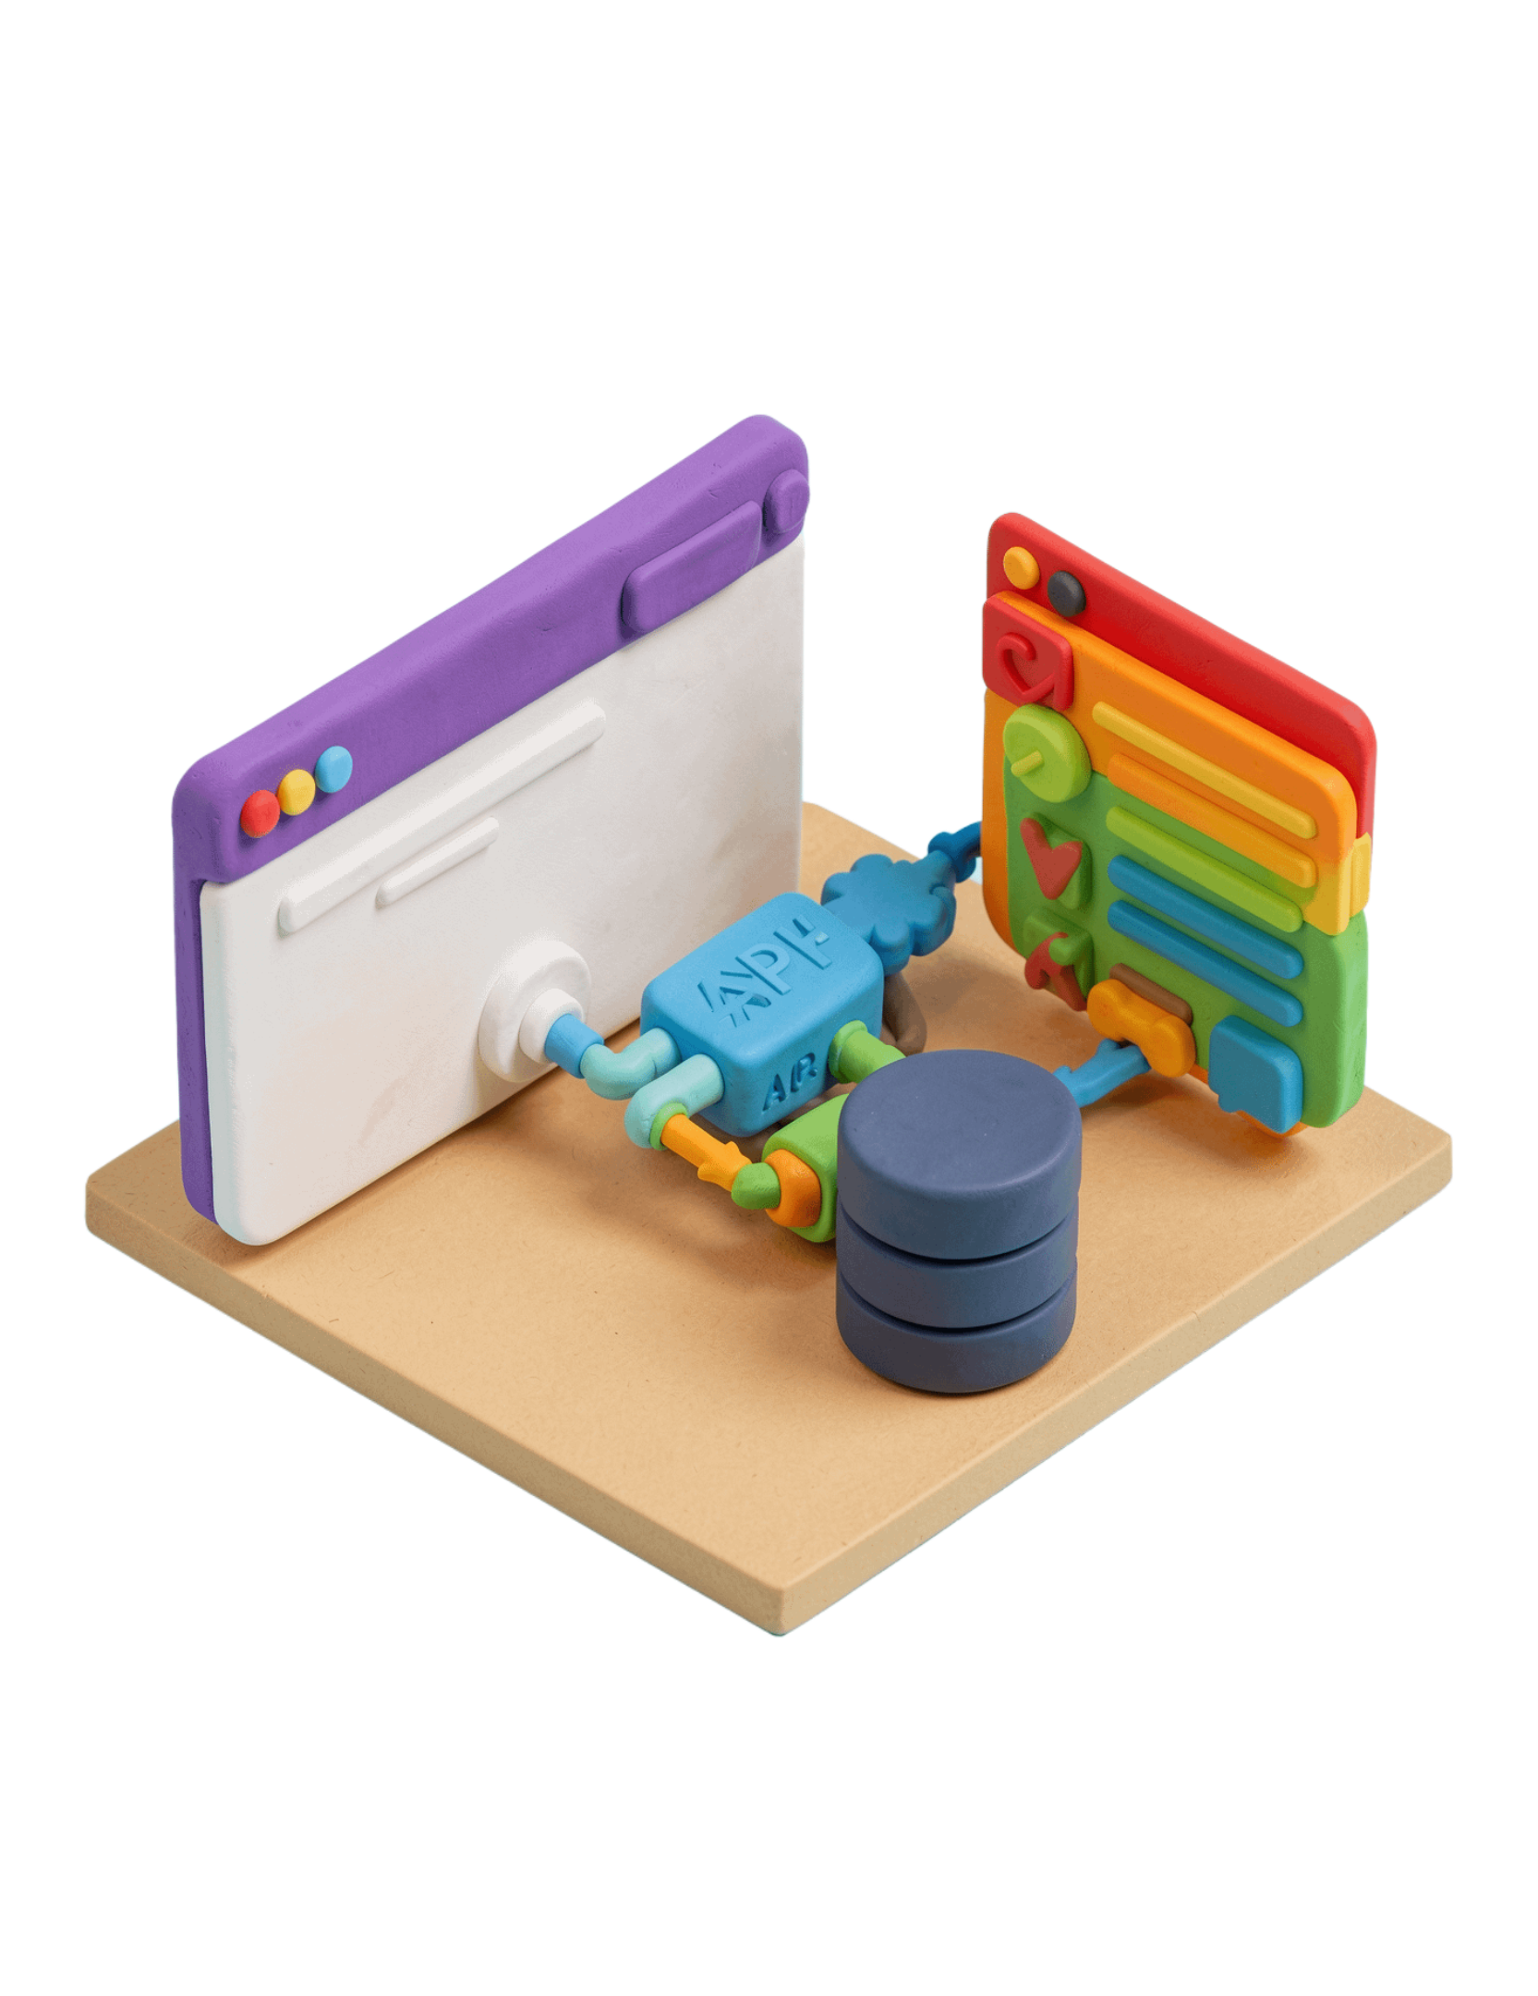
PARTIAL INTERNAL KNOWLEDGE
Gray-box testing
Gray-box testing combines external user-behavior testing with partial knowledge of the internal system.
The tester may know API structures, database schemas, or system architecture, but does not inspect every line of code.
Why use it?
It helps target realistic integration and data-flow risks while keeping the test close to user behavior.
Notes:
Gray-box testing sits between the two extremes. The tester uses selected knowledge of APIs, databases, or architecture to aim tests at integration and data-flow risks.

Slide 8








FROM APPROACH TO TEST CASE
White-box and black-box techniques in practice
WHITE BOX
BLACK BOX
How code executes
What the system produces
Statement coverage : ensures every line of code
is executed at least once during testing.
Equivalence partitioning : Divides input data into
partitions (groups) based on similar behavior.
Branch coverage : Verifies that all possible branches
(if/else conditions) in the code are tested.
Boundary-value analysis : Focuses on values at the
boundaries of input ranges.
Path coverage : Checks that all possible logical paths
through the code are executed.
Decision-table testing : Represents Conditions and
Actions in a structured table format.
Condition testing : Evaluates each individual logical
sub-condition separated by logical operators
State-transition testing : System moves from one
state to another due to a trigger/event.
Notes:
Contrast the questions, not just the technique names. White-box techniques derive evidence from code execution; black-box techniques derive cases from requirements and behavior.

Slide 9
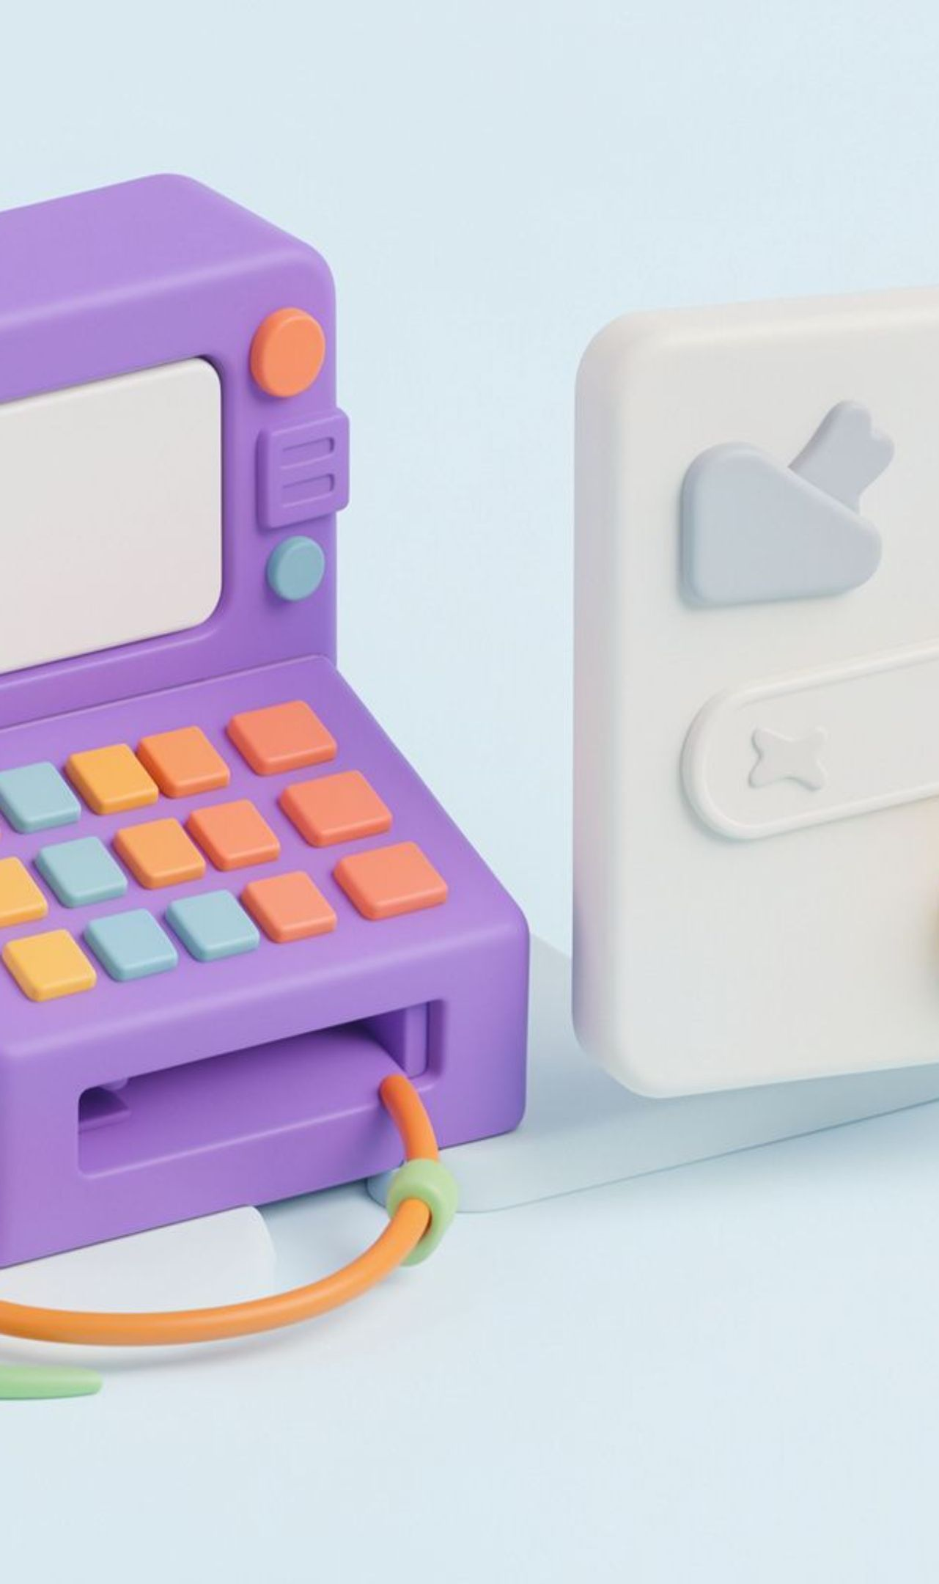

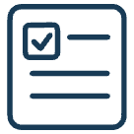

QA PRINCIPLES
QA Principles: Testing Finds Risk Early
1. Testing Shows the Presence of Defects
Testing finds bugs, but cannot guarantee that software is 100% bug-free.
Example: A calculator correctly adds 2 + 3, but gives the wrong answer for 5 × 4.
2. Exhaustive Testing Is Not Possible
Testing every possible input is impossible, so we test important cases.
Example: Instead of trying every password on a login page, we test a correct password and an incorrect password.
3. Early Testing
Testing should start as early as possible to find problems sooner.
Example: A tester finds a spelling mistake in a button label while reviewing the design, before the website is developed.

Slide 10
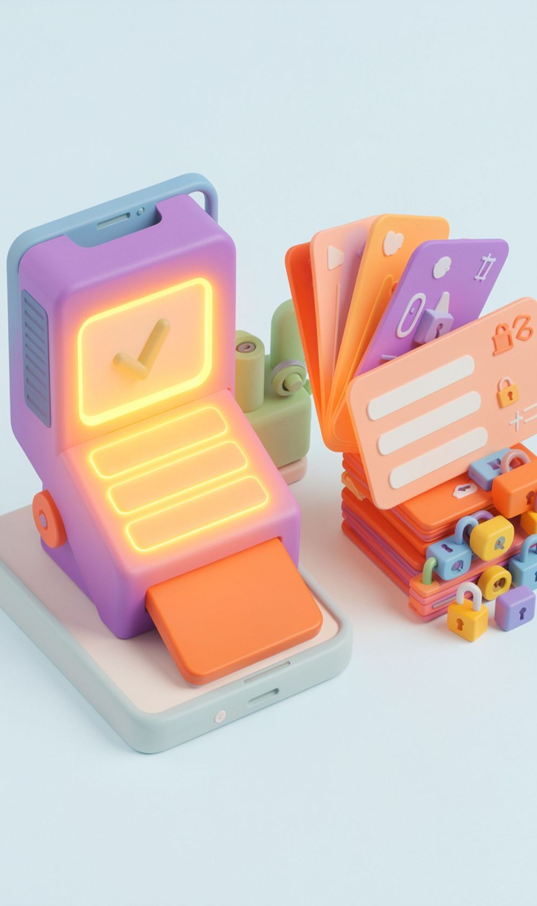


QA PRINCIPLES
QA Principles: Focus Where Defects Cluster
4. Defect Clustering
Most bugs are often found in a few parts of an application.
Example: A shopping app has many bugs on its payment page but very few on its home page.
5. Pesticide Paradox
Repeating the same tests may stop finding new bugs, so we need new test cases.
Example: After checking a login page with a correct password many times, we also test empty fields and incorrect passwords.

Slide 11
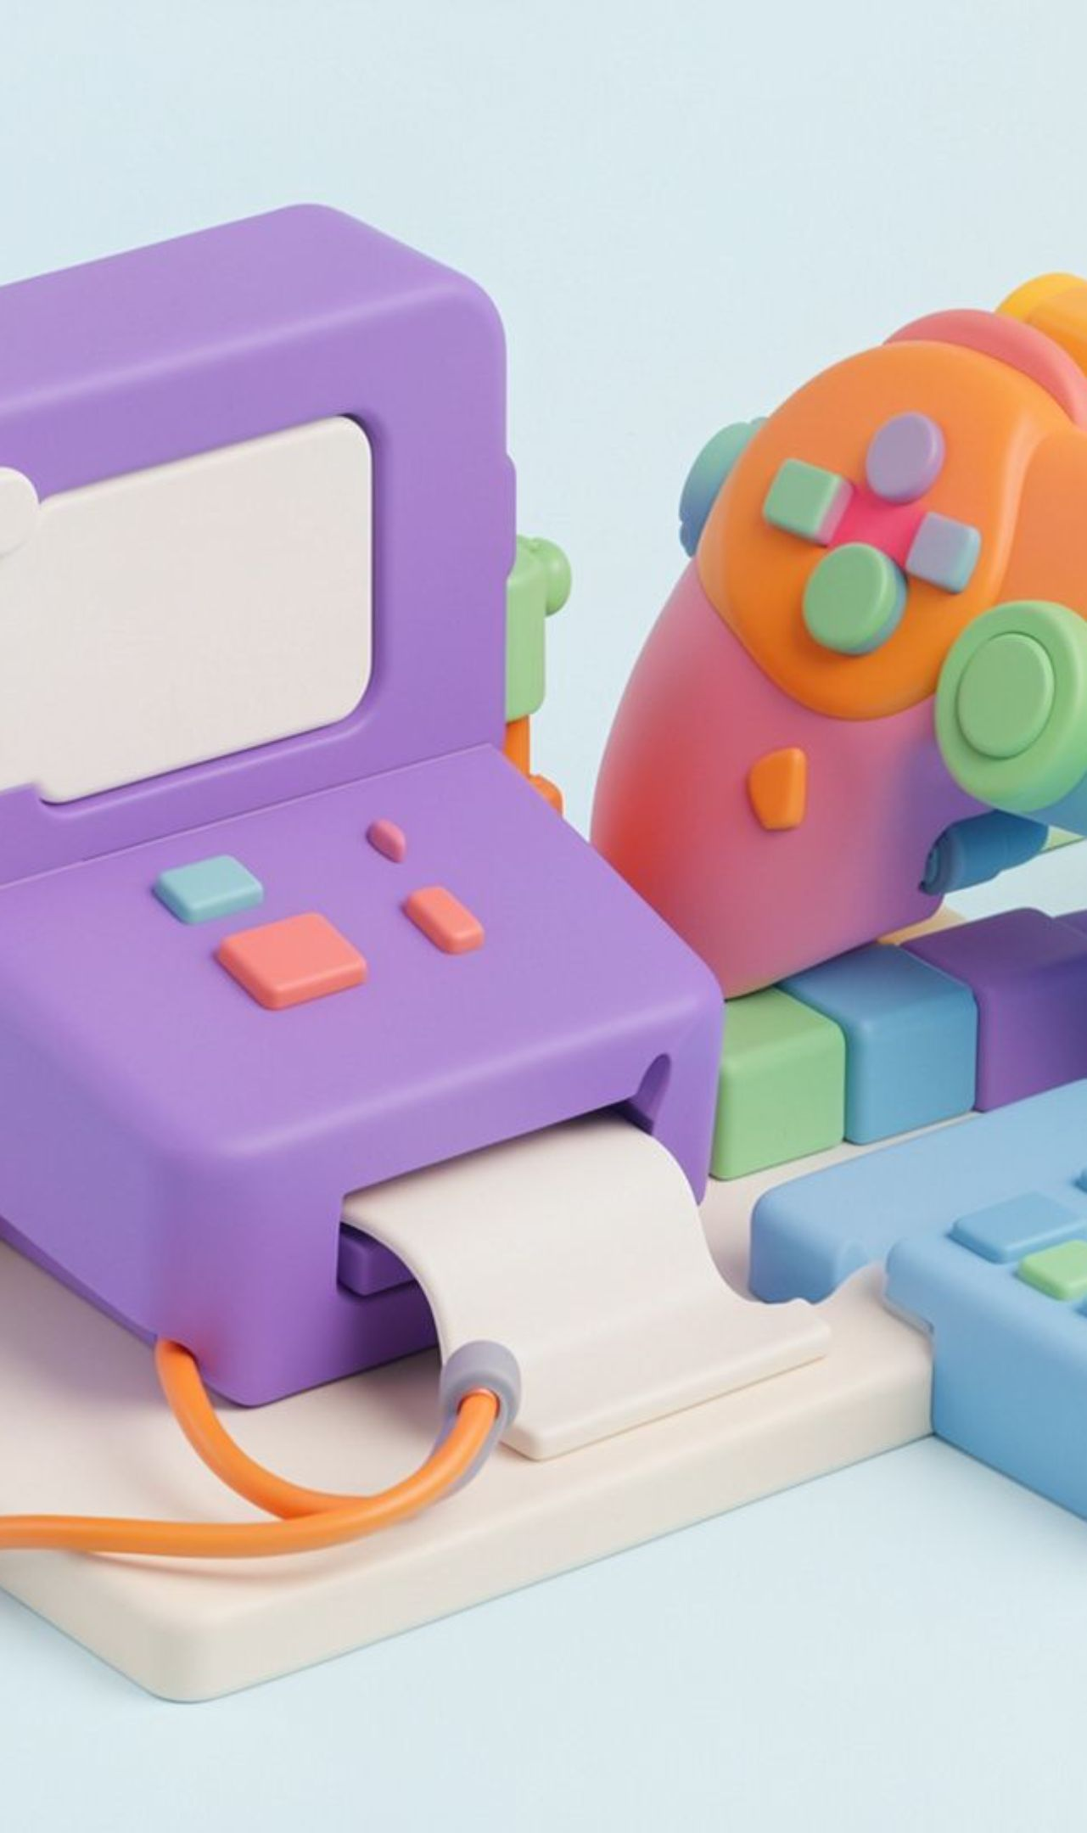


QA PRINCIPLES
QA Principles: Match Testing to the Context
6. Testing Is Context-Dependent
Different applications need different types of testing.
Example: A calculator needs correct calculations, while a game needs smooth gameplay.
7. Absence-of-Errors Fallacy
Software can be free of bugs but still fail to meet users' needs.
Example: A calculator app works perfectly , but does not have a multiplication function that users need.

Slide 12

FROM MISTAKE TO VISIBLE BEHAVIOR
Errors, Bugs/Defects, and Failures
Plan
Design
Implement
Review
Error
Bug / defect
Failure
A human mistake made during requirements, design, coding, or decision-making.
A problem in the software caused by an error and identified during review or testing; a confirmed defect is reported and tracked for correction.
The visible incorrect behavior that occurs when the software runs—for example, an application crashes or a login button does not respond.
Notes:
Walk through the chain in order. An error is made by a person, a defect is identified in the software, and a failure is what a user or tester can observe when the software runs.

Slide 13
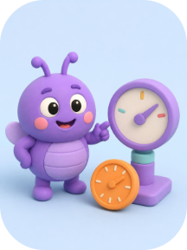
QA DEFECTS
Severity vs Priority in Software Testing
1. What is Severity?
2. What is Priority?
Severity indicates how seriously a defect affects the system's functionality.
Priority indicates how urgently a defect should be fixed.
It determines the order in which defects should be resolved.
Usually decided by the team based on business needs, often involving the Product Owner or project manager.
It measures the impact of a defect.
Usually assessed by the tester or QA team.
Examples:
Application crashes when opening the dashboard → High severity.
A minor spelling mistake on a page → Low severity.
Examples:
Payment fails for all customers → High priority.
A cosmetic issue on a rarely visited page → Low priority.
Notes:
Clarify the technical vs business distinction: Severity reflects functional failure depth, whereas Priority reflects commercial and scheduling urgency.

Slide 14
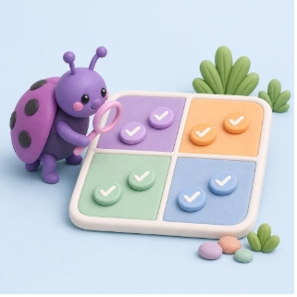
DEFECT TRIAGE
Severity and Priority combinations
Combination | Meaning | Example
High Severity + High Priority | Serious impact; urgent fix | Login completely broken for all users.
High Severity + Low Priority | Serious defect; fix may be scheduled later due to context | A rarely used legacy report crashes; it is temporarily disabled and has a planned replacement.
Low Severity + High Priority | Minor technical impact; business urgency is high | The company name is misspelled on the homepage before a major launch.
Low Severity + Low Priority | Minor impact; no immediate urgency | A small alignment issue on a rarely used page.
Easy way to remember: Severity = How serious is the defect? Priority = How soon should we fix it?
Notes:
Close with the 4 combinations matrix, using the memorable shorthand: Severity measures system impact, while Priority dictates triage scheduling.

Slide 15
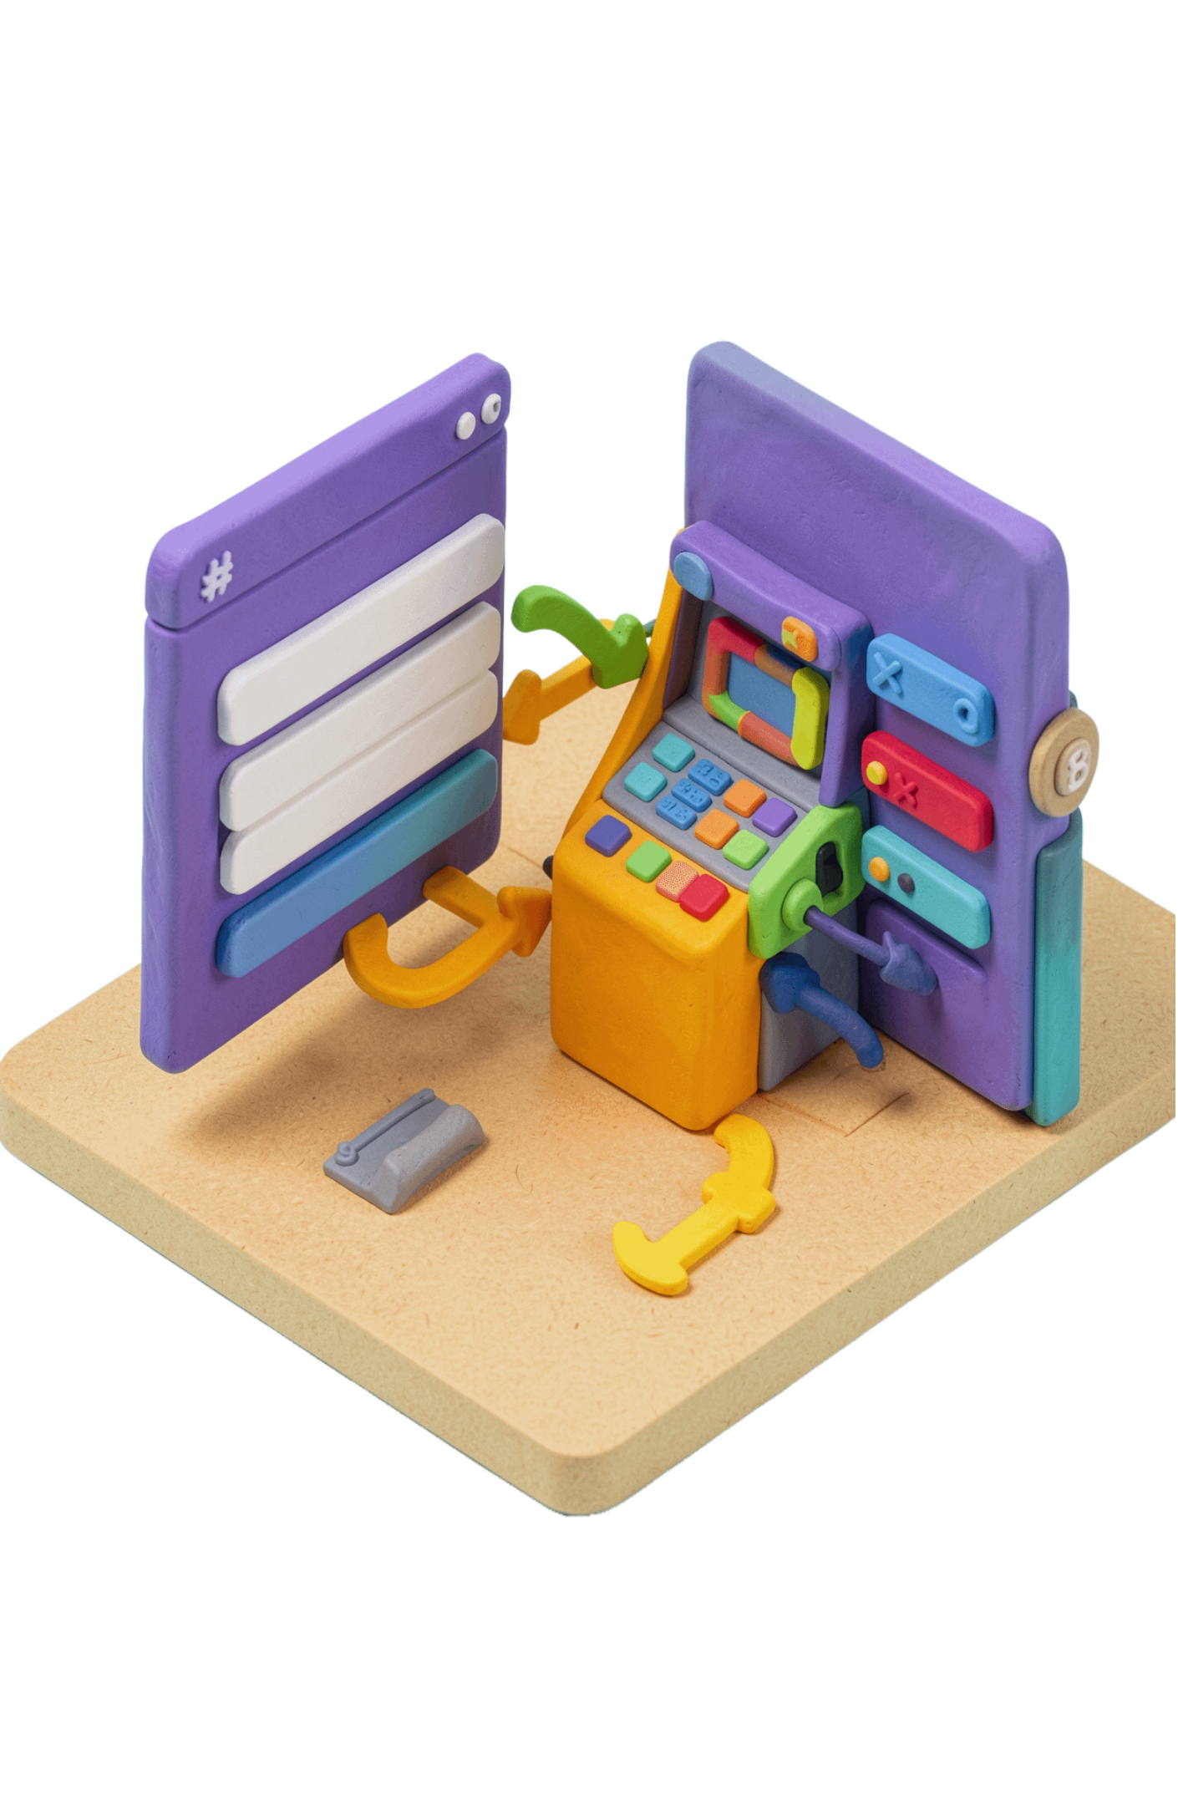
TESTING TYPES
Functional Testing
Functional testing verifies that the application performs defined functions according to requirements, using inputs and expected outputs.
Smoke
Sanity
Integration
System
Regression
User acceptance
Examples: verify login, validate an ATM withdrawal, confirm frontend-to-backend data flow, and check that a new release has not broken an existing feature.
Notes:
Functional testing is about whether defined functions work as required. Use the examples to connect the categories to recognizable checks: login, withdrawal, data flow, and protection against regression.

Slide 16
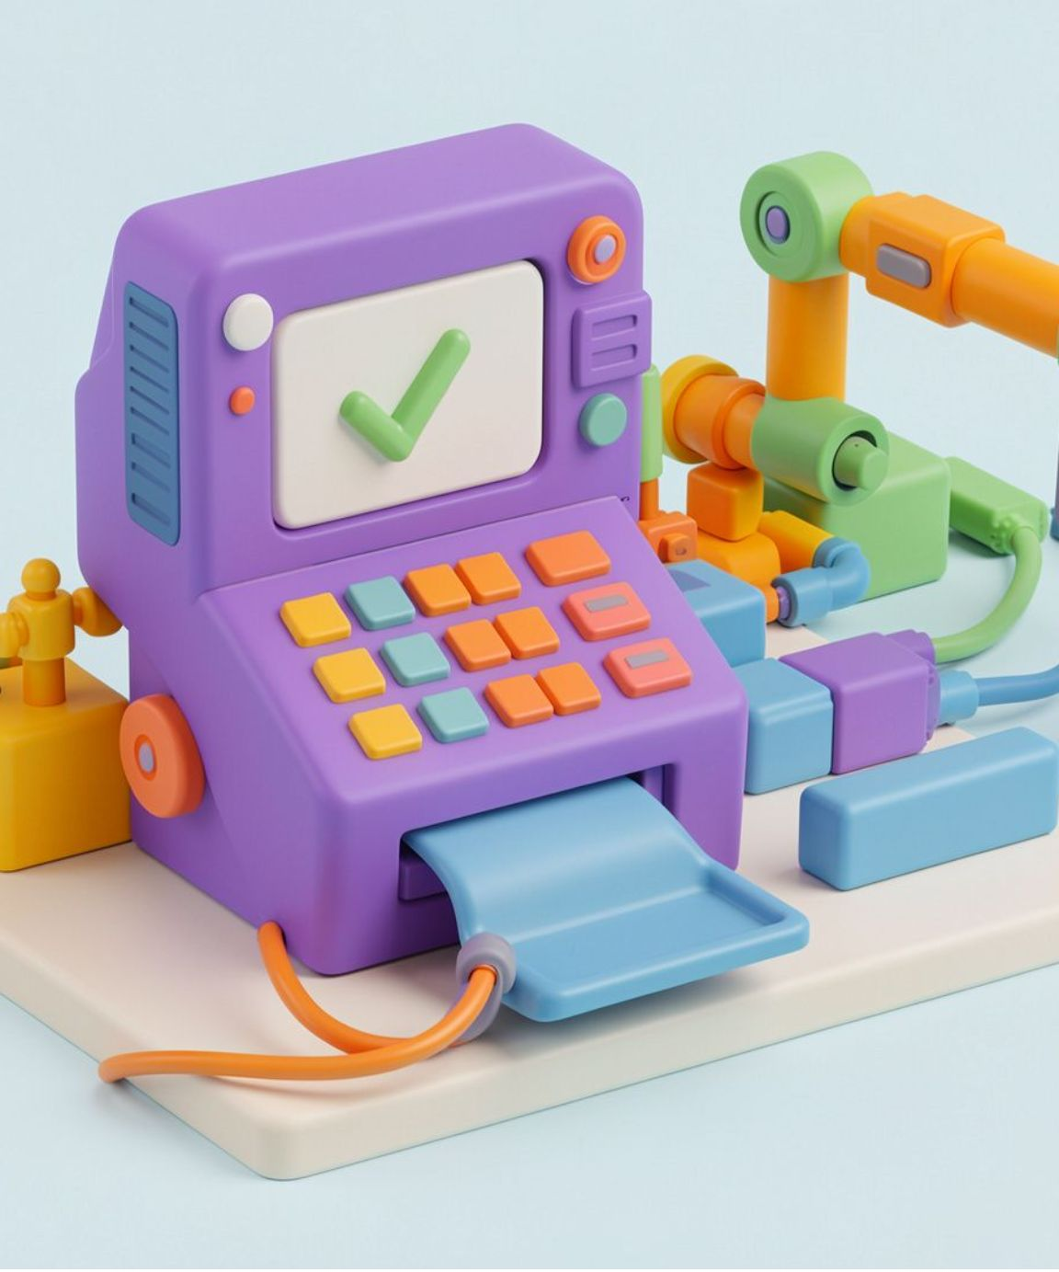


TESTING TYPES
Smoke / Sanity / Integration
Three checks, from quick confidence to connected systems.
Integration Testing
Smoke Testing
Sanity Testing
Checks whether different modules work together correctly.
Checks that the main features work after a new build.
Quickly checks whether a specific change or bug fix works correctly.
ATM example: It connects to the bank server and updates the balance after withdrawal.
ATM example: It starts, accepts a card, and shows the PIN screen.
ATM example: After a PIN fix, validation works as expected.

Slide 17
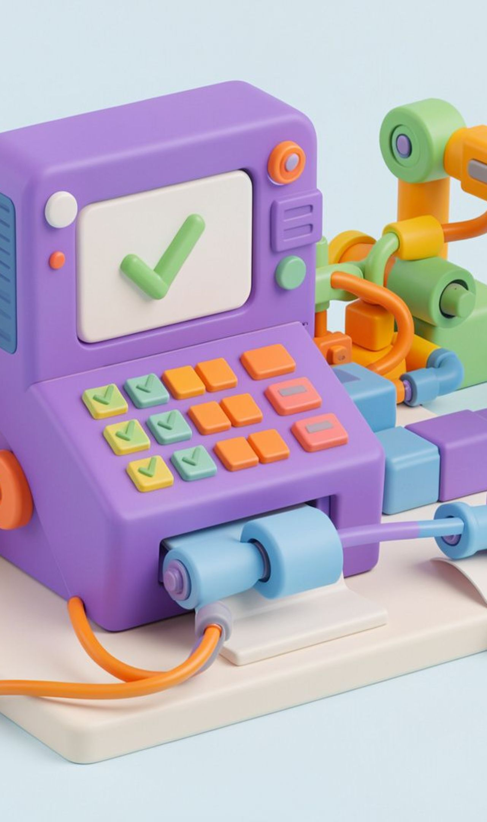



TESTING TYPES
System Testing / Regression Testing / User Acceptance Testing (UAT)
System Testing
Tests the complete application as a whole.
ATM example: Test the full ATM process, from card insertion to cash withdrawal and receipt generation.
Regression Testing
Checks that existing features still work after code changes.
ATM example: After updating the withdrawal feature, verify that balance enquiry still works.
User Acceptance Testing (UAT)
Checks whether the application meets users’ needs before release.
ATM example: Bank staff verify that the ATM works correctly for everyday customer transactions.

Slide 18
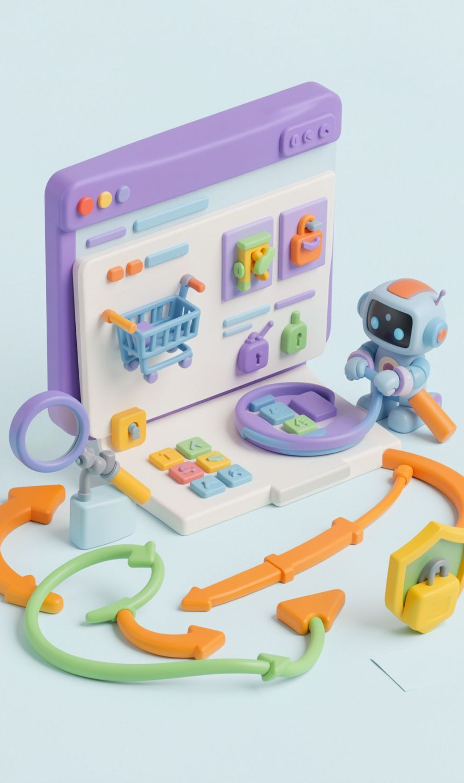



TESTING TYPES
Non-Functional Testing Types
Non-functional testing checks how well an application works, including usability, security, and behavior beyond specific business functions.
Usability Testing
Checks whether the application is easy to learn, understand, and use.
Example: A tester checks whether a first-time user can easily find a product, add it to the cart, and place an order on an online shopping website.
Security Testing
Checks whether the application protects user data and prevents unauthorized access.
Example: A tester tries to log in to a banking application using an incorrect password and checks whether one user can access another user's account.
Ad-Hoc / Exploratory Testing
Testers explore the application without strictly following predefined test cases to discover unexpected bugs. They learn, design, and execute tests as they go.
Example: A tester randomly clicks buttons, enters unusual inputs, refreshes pages, and navigates quickly through a shopping website to find unexpected errors.

Slide 19
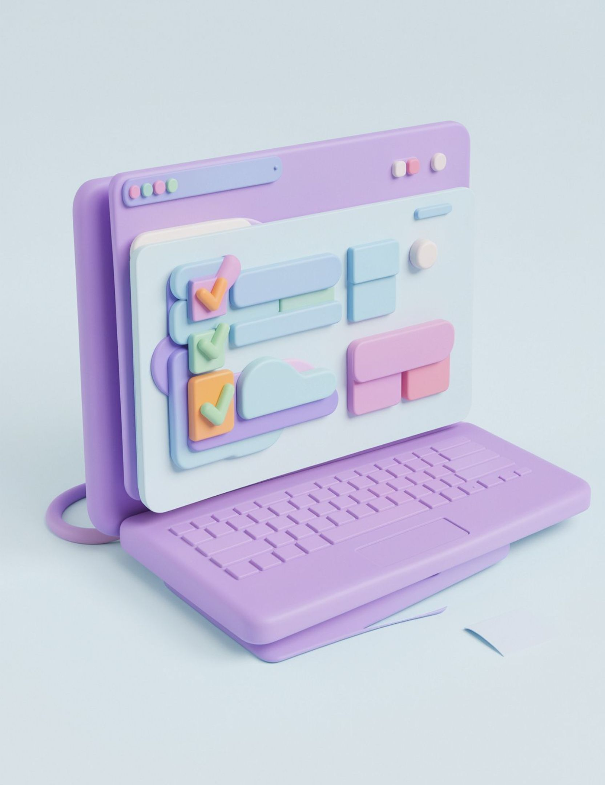
QA TERMS
Test Scenario
Explanation
Describes what functionality needs to be tested in an application.
Helps identify the different features that require testing.
Example
Check whether a user can log in to a website.
Check whether the website allows login with valid credentials.

Slide 20

QA TERMS
Test Case
Explanation
Describes the steps to test a particular functionality.
Specifies the actions and expected results to verify whether the feature works correctly.
Example
Open the website, enter a valid username and password, and click Login.
Verify that the user successfully reaches the home page.

Slide 21

Test Data in Software Testing
Definition
Test data is the input used to check whether software works correctly.
Key points
Tests real, invalid, boundary, and everyday inputs.
Finds defects across different scenarios.
Improves coverage and software quality.
Example
Login: valid details open the account; incorrect or empty details show an error.

Slide 22
Types of Test Data
Use the right data to test normal behavior, failures, limits, realism, and scale.
1
2
3
4
Valid Test Data
Invalid Test Data
Boundary Test Data
Null / Blank Test Data
Meets the rules and produces the expected result.
Breaks the rules to confirm errors are handled correctly.
Checks how required fields handle missing input.
Tests minimum, maximum, and just-inside/outside limits.
5
6
7
8
Random Test Data
Real Test Data
Synthetic Test Data
Large-Volume Test Data
Uses varied generated values to broaden coverage.
Mirrors real usage after sensitive data is protected.
Creates realistic test records without exposing private data.
Stress-tests performance with very large datasets.

Slide 23

QA DOCUMENTS
BRD — Business Requirements Document
A BRD explains what the business wants and what the application should do.
Key points
Captures business goals, user needs, and main requirements.
Uses simple language before development begins.
Example — Hospital Appointment Booking
Patients find doctors, book appointments, and receive confirmations. The goal is to reduce waiting time and make booking easier.

Slide 24
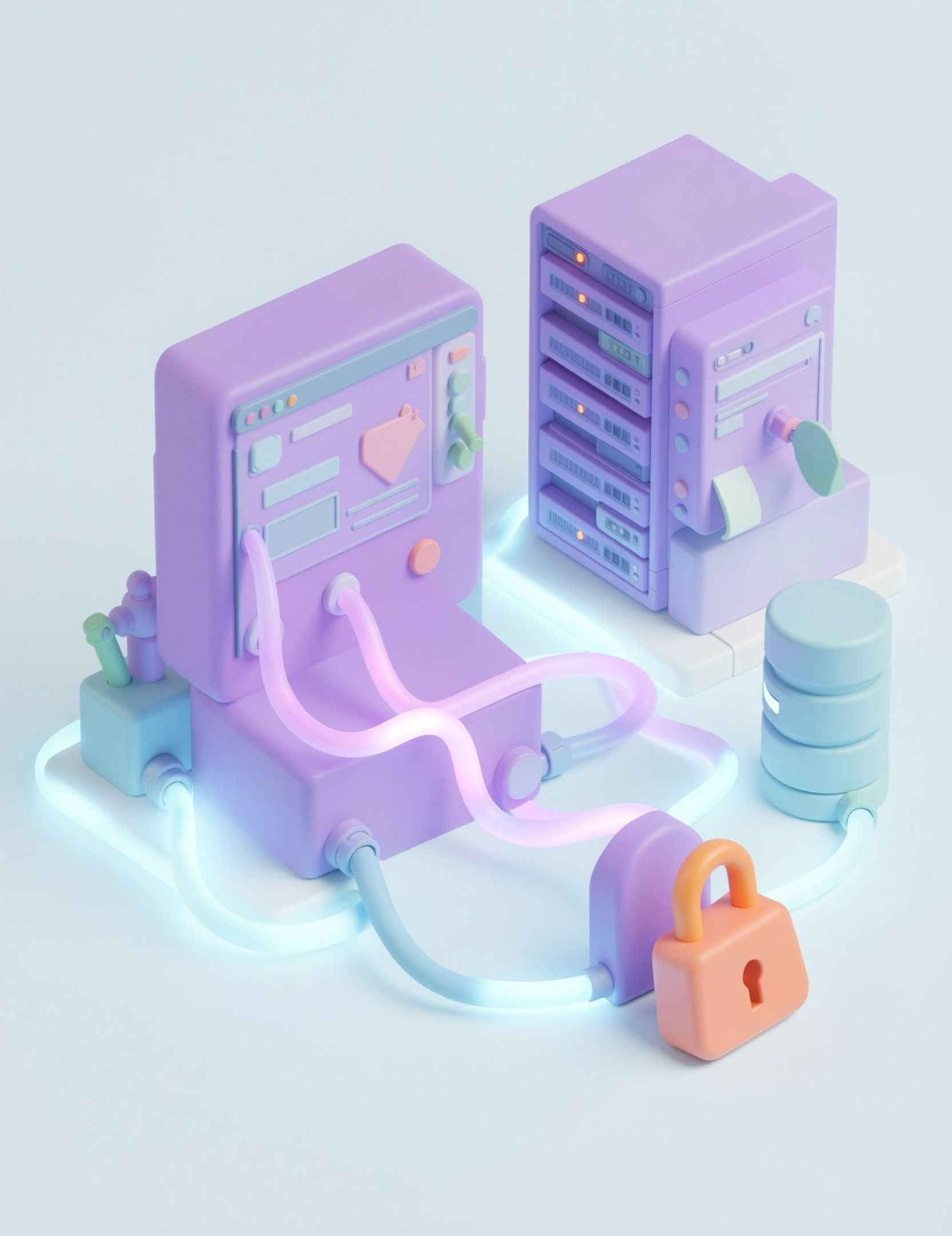
QA DOCUMENTS
TRD — Technical Requirements Document
A TRD explains the technical setup needed to build and protect the application.
Key points
Covers technologies, databases, APIs, security, and architecture.
Example — School Management System
React for the interface, Python FastAPI for the backend, PostgreSQL for student records, and secure login for students and teachers.

Slide 25
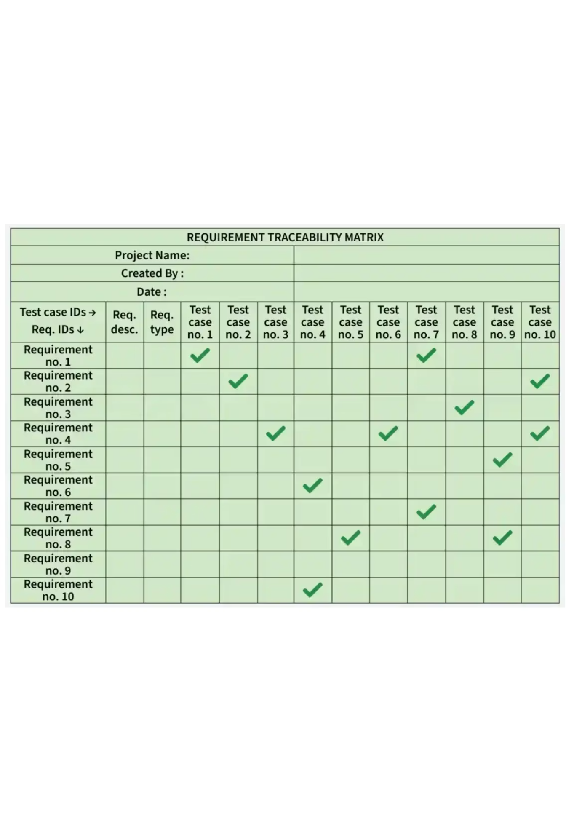
QA DOCUMENTS
RTM — Requirement Traceability Matrix
An RTM links each requirement to its test case so teams can track coverage.
Shows which requirements are covered, failed, or still untested.
Forward traceability: requirement → test case.
Backward traceability: test case → requirement.
Bidirectional traceability: both directions for complete coverage.
Example — Movie Ticket Booking
R01 Login → TC01 Pass; R02 Select seats → TC02 Pass; R03 Payment → TC03 Fail; R04 Download ticket → TC04 Not tested.
Green ticks show a link between a requirement and test case; they do not automatically mean the test passed.

Slide 26
QA DOCUMENTS
RTM Types
1
2
3
Forward Traceability
Backward Traceability
Bidirectional Traceability
Requirement → Test Case
Ensures every requirement has a matching test.
Test Case → Requirement
Confirms every test case belongs to a real requirement.
Requirement ↔ Test Case
Connects both directions for complete coverage and to find missing or unnecessary tests.
Example: The movie-seat requirement links to TC02.
Example: TC02 is checked against the movie-seat requirement.
Example: The movie-seat requirement links to TC02, and TC02 links back to that requirement.
Notes:
Walk through the three RTM directions: forward, backward, and bidirectional.

Slide 27





WATERFALL MODEL
Waterfall builds software in a fixed sequence
1. What it is
A traditional SDLC model where each phase completes before the next begins.
2. Example
An HR system like OrangeHRM with login, employee management, leave management, and dashboard.
3. Key features
Simple fixed sequence; clear requirements documented early; detailed documentation; easy progress tracking.
4. Remember
Requirements → Design → Development → Testing → Deployment → Maintenance.
Notes:
Introduce the Waterfall model as a structured, sequential framework where every step must finish before the next one starts.

Slide 28
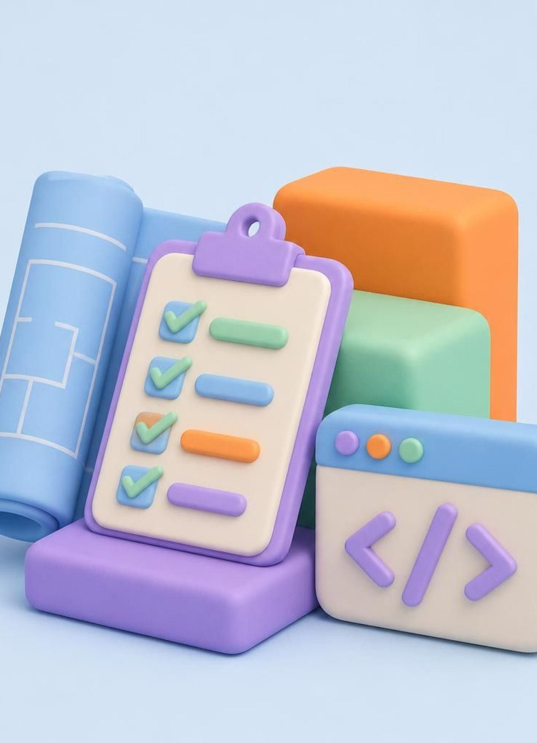



WATERFALL MODEL
Phases 1-3: Plan it, design it, build it
1. Requirements Analysis
document what the customer needs. Example: login, employee details, leave requests. Output: SRS
2. System Design
plan architecture, database, screens. Example: login screen, employee database, dashboard layout. Output: design documents
3. Development
code from the approved design. Example: authentication, leave management. Output: developed software
Notes:
Walk through the first half of the lifecycle: gathering expectations, architecting the blueprint, and writing the application code.

Slide 29



WATERFALL MODEL
Phases 4-6: Verify it, release it, keep it healthy
4. Testing
Find defects, verify requirements. Example: valid and invalid login, required-field checks. Output: test and defect reports.
5. Deployment
Release for real use. Example: HR app goes live for HR team and employees. Output: released software.
6. Maintenance
Fix and update after release. Example: fix a leave-balance calculation. Output: bug fixes and updates.
Notes:
Explain how quality assurance, deployment, and ongoing maintenance conclude the lifecycle once the build phase is complete.

Slide 30
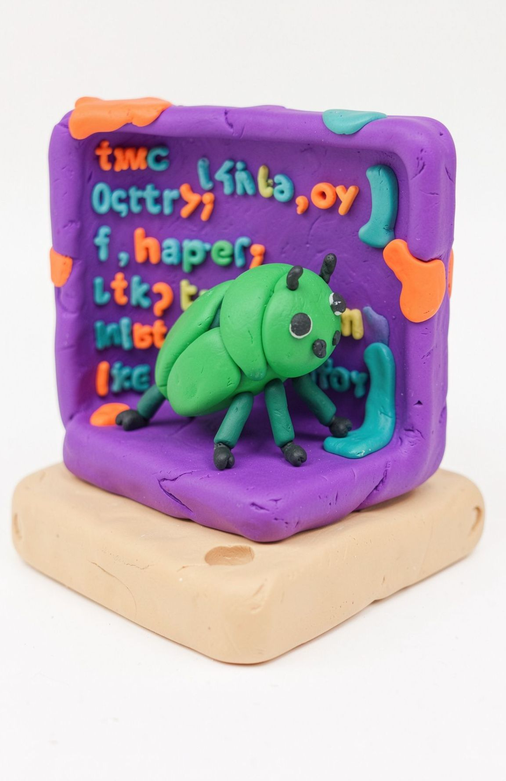
What Is a Software Bug?
A software bug is an error that causes an application to behave differently from its expected requirements.
Bug: Commonly refers to a coding or implementation error.
Defect: Any deviation from the specified requirements.
Importance: Identifying bugs improves software quality, reliability, and user experience.
Notes:
A bug is a coding error; a defect is any deviation from the specified requirements. Finding them early improves quality, reliability and user experience.

Slide 31
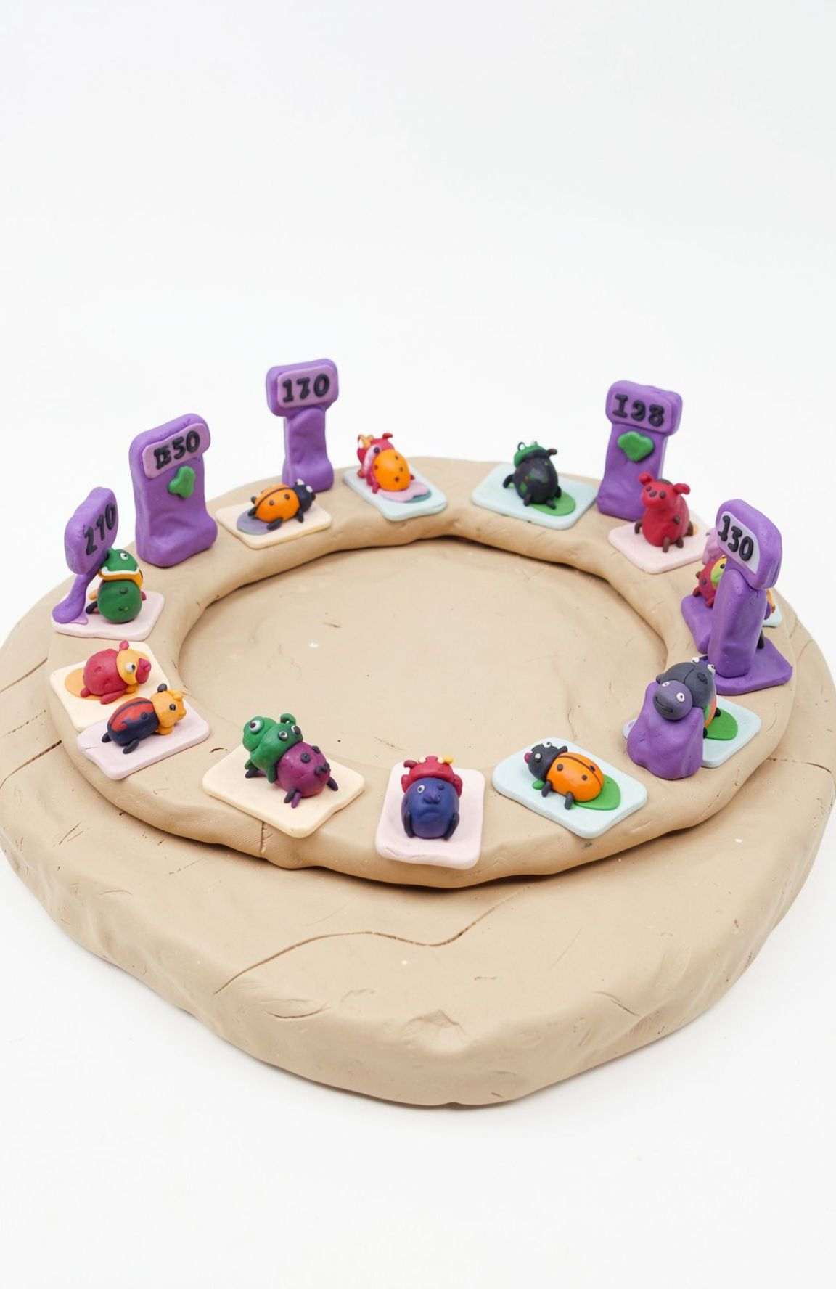
Bug Life Cycle
The Bug Life Cycle is the sequence of stages a defect follows from identification to final closure.
Objectives:
Track defects systematically.
Assign responsibility to the appropriate team.
Ensure fixes are tested and verified.
Improve communication between testers and developers.
Key participants: Tester, QA Lead, Developer, and Project Manager.
Notes:
Walk through the four objectives and name the four participants who share the bug life cycle.

Slide 32


Bug Life Cycle Workflow
Main flow
New
→
Assigned
→
Open
→
Fixed
↓
Pending Retest
→
Retest
→
Verified
→
Closed
Alternative statuses from Open
Duplicate
Rejected
Deferred
Not a Bug
Reopened path: If the bug fails retesting, move it to Reopened and return it to Assigned/Open for further investigation.
Notes:
Follow the main flow left to right, then show the four alternative exits from Open and the reopen loop after a failed retest.

Slide 33

Bug Statuses and Responsibilities
Status | Responsible Person | Action
New | Tester | Report the defect
Assigned | QA Lead | Assign to developer
Open | Developer | Investigate the issue
Fixed | Developer | Implement the fix
Pending Retest / Retest | Tester | Test the fix
Verified | Tester | Confirm resolution
Closed | QA/Tester | Close the defect
Reopened | Tester | Return for further fixing
Duplicate | QA Lead | Link to existing defect
Deferred | QA Lead/PM | Postpone to a later release
Rejected / Not a Bug | QA Lead/Developer | Document the reason and close
Notes:
Each status has one owner and one action. Use this table to confirm who acts at every stage of the bug life cycle.

Slide 34

AGILE BASICS
Agile builds in small parts and values people, software, and change
Agile is a software development approach in which a product is developed in small parts, tested regularly, and improved using customer feedback. Example: an online shopping app gets login first, then product search, shopping cart, and finally payment.
Individuals and interactions over processes and tools: a tester directly discusses a bug with a developer.
Customer collaboration over contract negotiation: the team discusses how to add a requested coupon feature.
Working software over comprehensive documentation: demonstrate a working shopping cart instead of only documents.
Responding to change over following a plan: add the coupon feature to the backlog and prioritize it.
Notes:
Emphasize the four core Agile Manifesto trade-offs, showing how each one prioritizes human interaction and running software over rigid administrative overhead.

Slide 35

SCRUM FRAMEWORK
Scrum organizes work into Sprints
Scrum is an Agile framework built around fixed-length periods called Sprints, commonly one to four weeks. Our example uses a two-week Sprint where the team develops and tests the shopping cart feature.
1. Roles
Who is responsible for the work across vision, facilitation, and execution?
2. Artifacts
What work needs to be done, refined, and tracked across the release?
3. Ceremonies & Events
How does the cross-functional team plan, coordinate, inspect, and adapt daily?
Notes:
Scrum provides structured cadence. Highlight the 3 pillars: Roles, Artifacts, and Ceremonies, showing how they make a two-week shopping cart cycle manageable.

Slide 36

SCRUM ROLES
Three roles share the responsibility
Product Owner
Defines the product vision; prioritizes by customer and business value; maintains the Product Backlog; clarifies requirements; reviews results against acceptance criteria. Example: Checkout comes before product animations.
Scrum Master
Helps remove blockers; facilitates Scrum events; encourages collaboration; protects the team's focus. Example: Coordinates access to a testing environment.
Developers / Scrum Team
Organize their work; develop and test features; estimate and complete selected work. Example: Developers build the cart; testers verify adding and removing products and the total price.
Note: a team size of 5–9 is a traditional guideline, not a mandatory Scrum rule.
Notes:
Explain that Scrum replaces command-and-control hierarchy with shared accountability across the Product Owner, Scrum Master, and Developers.

Slide 37

SCRUM ARTIFACTS
Backlogs and Sprints track the work
Product Backlog
An ordered list of all work that may be needed. The Product Owner manages it; items are ordered by value, and anyone can suggest new items.
Example: Login, product search, add to cart, apply coupon, payment, order tracking.
Sprint
A fixed-length period working toward a Sprint Goal and producing a usable increment.
Sprint Backlog
The Sprint Goal, selected items, and the plan. Tasks need not be pre-assigned.
Example: Search by name, filter by category, display results, test search.
Notes:
Artifacts guarantee full transparency. Show how items migrate from the global Product Backlog into the committed Sprint Backlog for delivery.

Slide 38
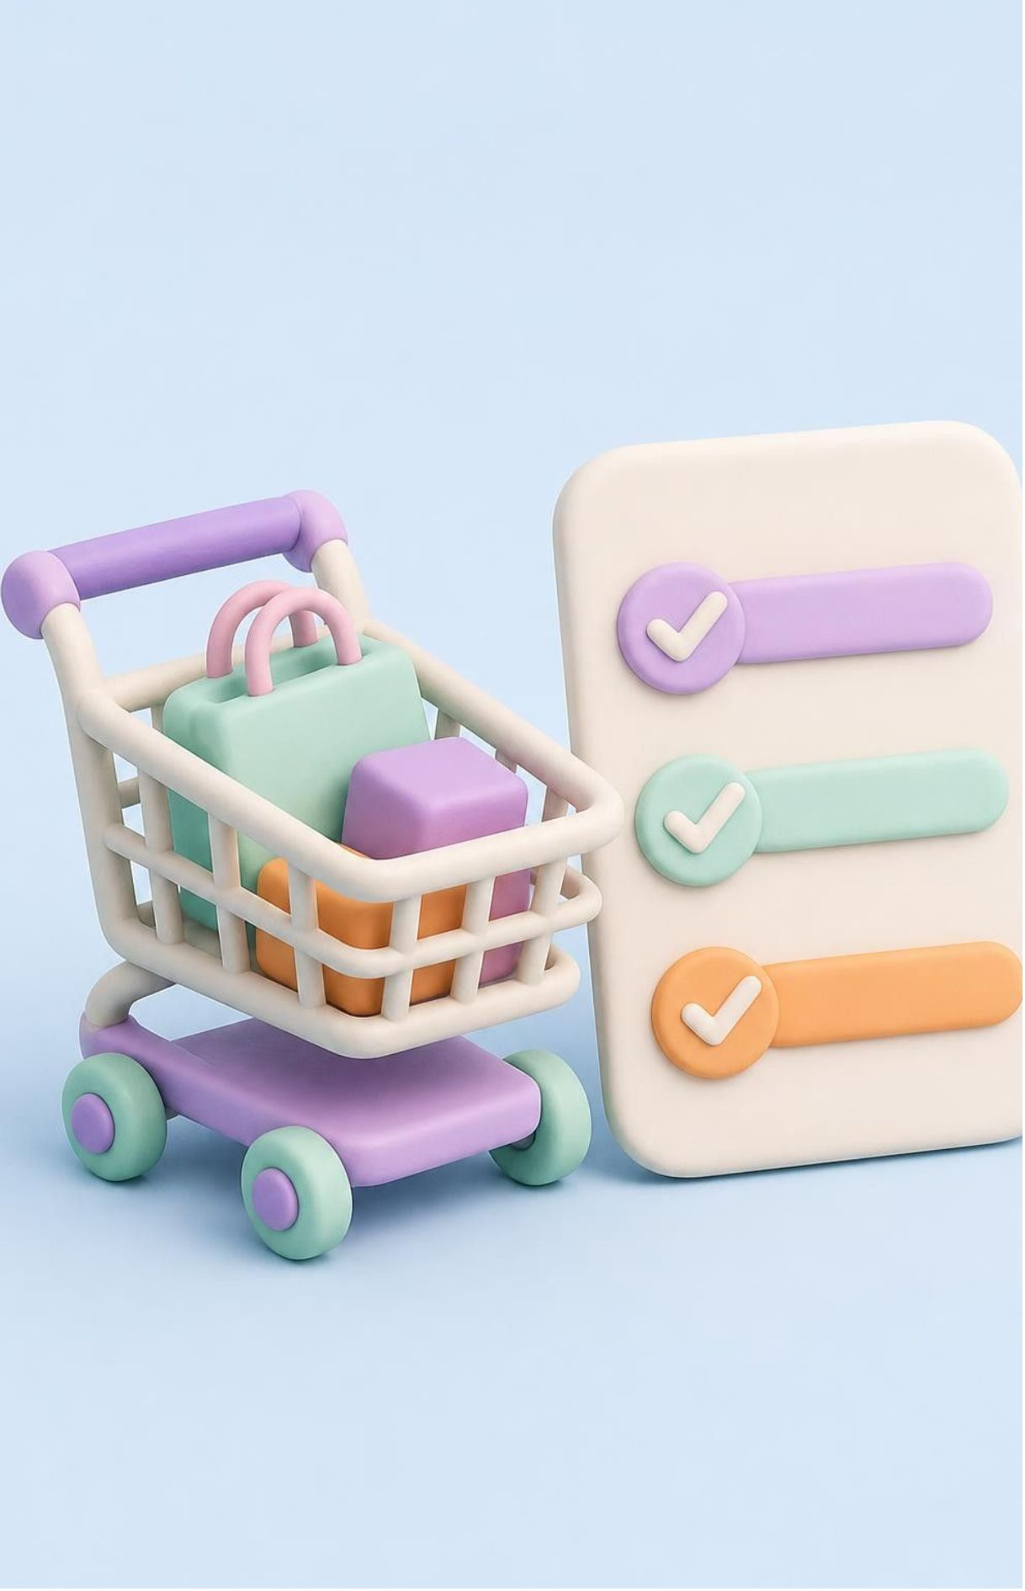
REQUIREMENTS
User stories and acceptance criteria define the feature
User Story format: As a [user], I want [feature], so that [benefit].
Example: As a customer, I want to add a product to my cart so that I can purchase it later.
Acceptance Criteria
The customer can add an available product.
The product appears in the cart.
The correct product price is displayed.
The cart total updates when the quantity changes.
An unavailable product cannot be added.
These criteria help developers understand requirements and testers prepare test cases.
Notes:
User stories capture intent, while acceptance criteria establish boundary conditions. Walk through the shopping cart test cases as proof of unambiguous definitions.

Slide 39

SPRINT CEREMONIES
Scrum Environment Ceremonies
Backlog Refinement
Product Owner and Developers clarify requirements, discuss acceptance criteria, identify dependencies, and break down large stories.
An ongoing activity, not an official Scrum event.
Example: Should expired coupons be rejected?
Sprint Planning
Product Owner, Scrum Master, and Developers set the Sprint Goal, select items, consider capacity, and create a work plan.
Example: Product search and category filtering for a two-week Sprint.
Notes:
Distinguish continuous refinement from the formal planning event. Refinement keeps the backlog ready, while planning commits to the next Sprint Goal.

Slide 40
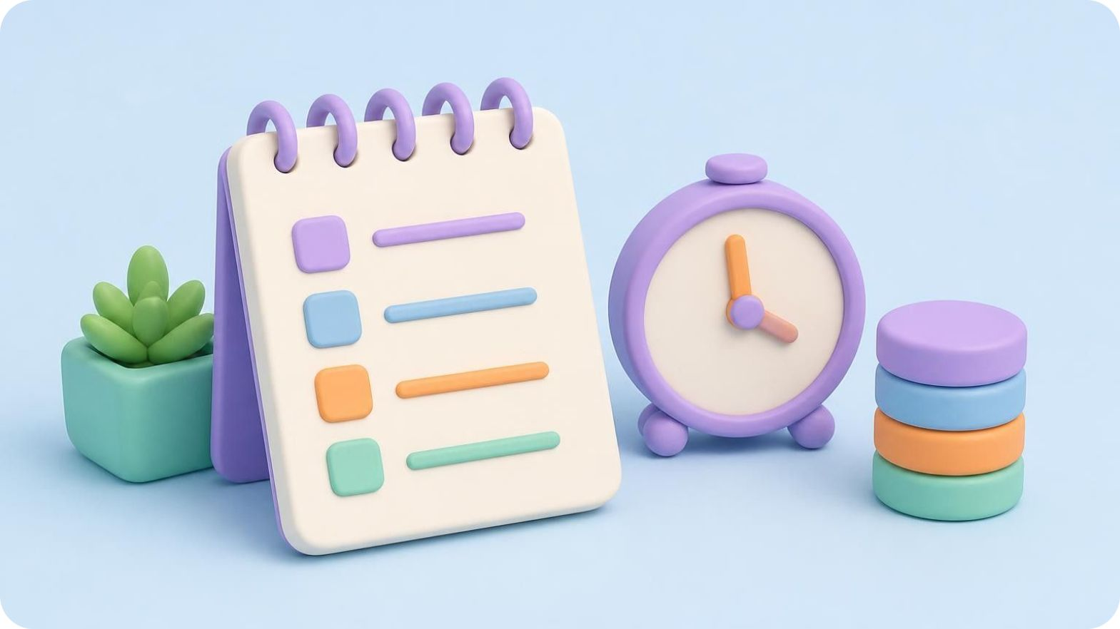
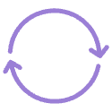


SPRINT CEREMONIES
Scrum Environment Ceremonies
Daily Scrum (15 min)
Sprint Review
Sprint Retrospective
Demonstrate the working increment to stakeholders and gather direct customer feedback.
What did I complete yesterday, what will I do today, and are there any blockers?
Inspect team workflow: what went well, what went wrong, and what to improve next.
Example: Tested search; testing filters; blocker: no test data.
Example: The customer tests the build and requests a price-range filter.
Example: Test data arrived late, so prepare test datasets before testing begins.
Notes:
Highlight the closing inspection cadence: Daily Scrum coordinates execution, Review validates the product increment, and Retrospective refines the team's working process.

